Slide 2
What is math problem-solving?
Problem solving is when you are presented with a math problem and you have to figure out a way to answer the question that the problem is asking you.
The important thing is to try your best to put yourself in the scenario!

Slide 3
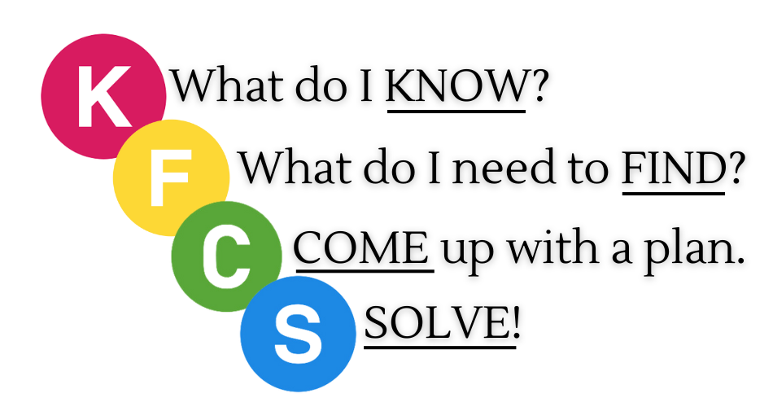
Problem-Solving can be tricky…
…but not if you use

Slide 4
No! Not the Chicken!
K – stands for “What information do I Know?”
F – stands for “What am I trying to Find out?”
C – stands for “Come up with a plan!”
S – stands for Use strategy and “Solve!”

Slide 5
The K stands for what do I know?
K = What Information Do I KNOW?
Read the word problem and think of all the information you are given.
Write down all of the information you have been given that’s necessary to figure out this problem.

Slide 6
The F stands for what do I need to FIND?
K = What Do I NEED TO FIND?
Read the word problem again and focus on what they want you to find.
Once you have clarified what they want you to find, you are ready to come up with a plan to solve it.

Slide 7
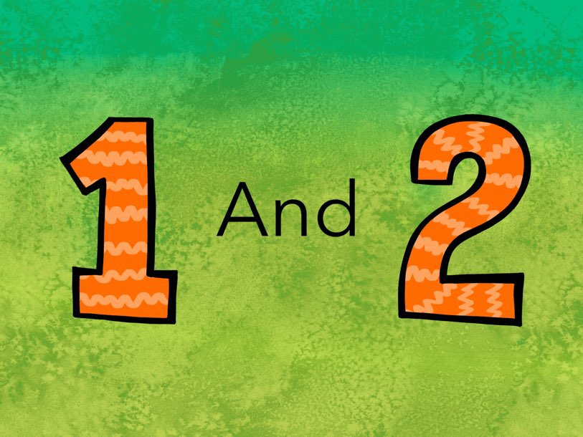
The PLAN you come up with must have two parts!
Come Up With a Plan
What operation will I need to use?
addition, subtraction, division, multiplication,
ordering, comparing, and/or estimating …?
Imagine the word problem, picture the actions, and visualize what is happening!

Slide 8
Operations – Key Situations
Addition | Subtraction
Part – Part = Whole No Whole No Starting Number No Total | Part – Part = Whole No Part
Multiplication | Division
Equal Groups or Each No Total Number | Equal Groups or Each No Number of Groups or Rows No Numbers in each Group or Rows
?
W
_
_
_
_
P
P
P
?
+
+
?
W
÷
÷
÷
÷
P
P
P
?
x
x

Slide 9
The PLAN you come up with must have two parts!
Come Up With a Plan
What problem solving strategy will I choose to use?
What do I need to answer the question?

Slide 10
Problem Solving Strategies
Act it out
Draw a picture
Solve a Simpler Problem
Use Logical Reasoning
Work Backward
Write an Equation
Write a Number Sentence
Use an Array
Make an Organized List
Make a Table / Chart / T-Chart
Use Estimation
Use Mental Math
Make a Number Line
Find a pattern
Guess and Check

Slide 11
The S stands for SOLVE?
S = Use Your Plan and SOLVE!
Use the plan you decided on.
Draw or write it out and get your answer. After you get your answer, write your answer out in a complete sentence!

Slide 12
Let’s try it!
Here’s the problem:
Paul received four postcards from each of his father’s 11 trips. How many postcards did Paul receive from all the 11 trips?

Slide 13
STEP ONE:
The first step is “K” or “What do you know and need to solve the problem?”
Paul received four postcards from each of his father’s 11 trips. How many postcards did Paul receive from all the 11 trips?

Slide 14
K | F
What do I know? Received 4 postcards Each of 11 trips In this column, students will record information from the word problem that is important! Students will also record any relevant background knowledge needed for solving a problem (i.e. a square has four sides). | What am I trying to find out? In this column, students will record the question. Some questions involve answering more than one question. Students must record all the questions they are solving for!
C | S
Come up with a plan! Operation- Strategy- In this column, students will decide which operation they will use. Students will also choose a problem-solving strategy to use (i.e. draw a picture, write a number sentence, use a number line, etc.) | Use your strategy and solve! Students must solve the word problem using the strategy they chose, and come up with an answer. Students must show work!

Slide 15
STEP TWO:
The next step is “F” or “What am I trying to find out?”
Paul received four postcards from each of his father’s 11 trips. How many postcards did Paul receive from all the 11 trips?

Slide 16
K | F
What do I know? Received 4 postcards Each of 11 trips In this column, students will record information from the word problem that is important! Students will also record any relevant background knowledge needed for solving a problem (i.e. a square has four sides). | What am I trying to find out? How many postcards did Paul receive from all the 11 trips? In this column, students will record the question. Some questions involve answering more than one question. Students must record all the questions they are solving for!
C | S
Come up with a plan! Operation- Strategy- In this column, students will decide which operation they will use. Students will also choose a problem-solving strategy to use (i.e. draw a picture, write a number sentence, use a number line, etc.) | Use your strategy and solve! Students must solve the word problem using the strategy they chose, and come up with an answer. Students must show work!

Slide 17
STEP THREE:
The next step is “C” or “Come up with a plan!”
Paul received four postcards from each of his father’s 11 trips. How many postcards did Paul receive from the 11 trips?

Slide 18
K | F
What do I know? Received 4 postcards Each of 11 trips In this column, students will record information from the word problem that is important! Students will also record any relevant background knowledge needed for solving a problem (i.e. a square has four sides). | What am I trying to find out? How many postcards did Paul receive from the 11 trips? In this column, students will record the question. Some questions involve answering more than one question. Students must record all the questions they are solving for!
C | S
Come up with a plan! Operation – Given the Number of rows & Number in each row; no total (Multiply) Strategy – Use an Array or number sentence In this column, students will decide which operation they will use. Students will also choose a problem-solving strategy to use (i.e. draw a picture, write a number sentence, use a number line, etc.) | Use your strategy and solve! Students must solve the word problem using the strategy they chose, and come up with an answer. Students must show work!
?
÷
÷
P
P
x

Slide 19
STEP FOUR:
The next step is “S” or “Solve!”
Paul received four postcards from each of his father’s 11 trips. How many postcards did Paul receive from the 11 trips?

Slide 20
K | F
What do I know? Received 4 postcards Each of 11 trips In this column, students will record information from the word problem that is important! Students will also record any relevant background knowledge needed for solving a problem (i.e. a square has four sides). | What am I trying to find out? How many postcards did Paul receive from the 11 trips? In this column, students will record the question. Some questions involve answering more than one question. Students must record all the questions they are solving for!
C | S
Come up with a plan! Operation – Given the Number of rows & Number in each row; no total (Multiply) Strategy – Use an Array or number sentence In this column, students will decide which operation they will use. Students will also choose a problem-solving strategy to use (i.e. draw a picture, write a number sentence, use a number line, etc.) | Use your strategy and solve! 0 0 0 0 0 0 0 0 0 0 0 0 0 0 0 0 0 0 0 0 0 0 0 0 4 x 11 = 44 0 0 0 0 0 0 0 0 Paul received 44 0 0 0 0 postcards. 0 0 0 0 0 0 0 0 Students must solve the word problem using the strategy they chose, and come up with an answer. Students must show work!
?
44
÷
÷
÷
÷
4 in each row
P
P
11
4
x
x
11 rows

Slide 21
The answer is Paul received 44 postcards
Paul received four postcards from each of his father’s 11 trips. How many postcards did Paul receive from all the 11 trips?

Slide 22
Now it’s your turn!
On Brown’s farm, there are 20 goats and 12 chickens. How many number of legs of goats and chickens are there?

Slide 23
Problem-Solving can be tricky…
…but not if you use

